Slide 1









Macau AI Challenge 2019
Host Units:
Department of Computer and Information Science
Support Units:

Slide 2

AI Workshop Session 1
Ryan L.H. U 余亮豪
Associate Professor State Key Lab of Internet of Things for Smart City
Department of Computer and Information Science University of Macau

Slide 3
Background Introduction
1
Let’s start with the first part of slides

Slide 4

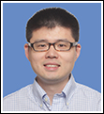
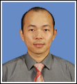
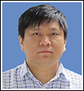
Working Team
University of Macau
Prof. Ryan L.H. U (余亮豪)
Research interests: Big Data Processing
Prof. Yibo Bob ZHANG (張一博)
Research interests: Image Processing
Prof. Derek Fai Wong (黃輝)
Research interests: Natural Language Processing
Prof. Long CHEN (陳龍)
Research interests: Cybernetics
Alibaba Cloud
Emma WU

Slide 5

Why do we have this Challenge Competition?

Slide 6
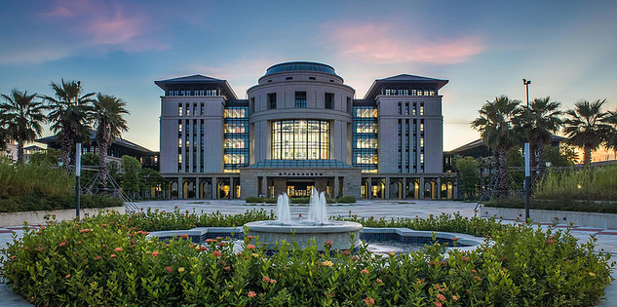
State Key Lab of Internet of Things for Smart City 智慧城市物联网国家重点实验室
1

Slide 7
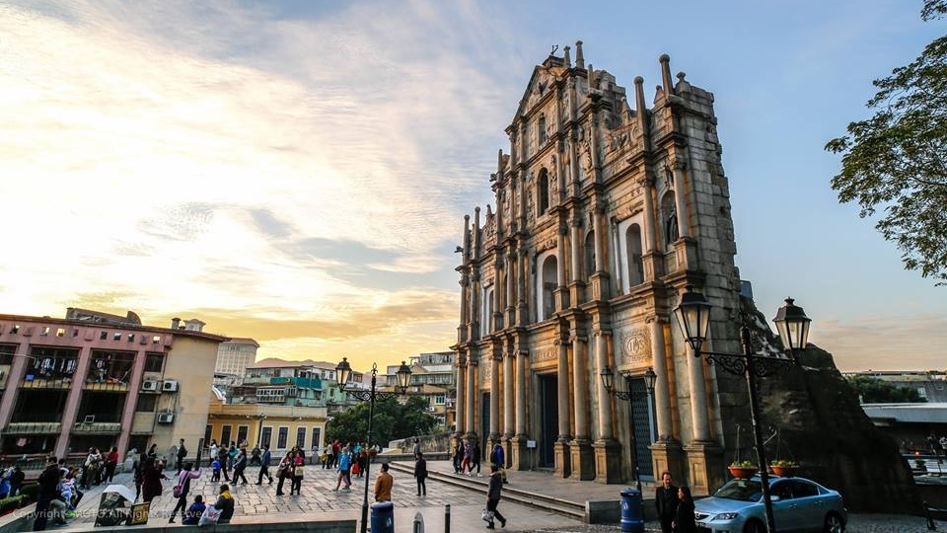
充分利用“一个平台”的优势，实现物联网模块深度融合
立足新的高度和战略布局，澳门大学为澳门物联网技术的持续发展及多学科的交叉融合奠定良好基础。澳门大学宋永华教授长期引领能源物联网领域，做出开创性的重大贡献，在智能交通物联网等领域成果丰硕，在海内外享有盛誉，是广受尊重的行业领导人。在物联网其他关键技术领域，如传感、标签、识别、定位、追踪、数据分析等，澳门大学均有优异的本土研究团队。
协助市民上升流动，培养和积累物联网技术和人才。在澳门本地拟建立一个高质量的技术及人力资源平台，包括软件设计和测试设备的硬件平台，多方位培养建设澳门、服务国家的高素质人才，为支撑粤港澳大湾区的经济增长提供有力的人才储备

Slide 8
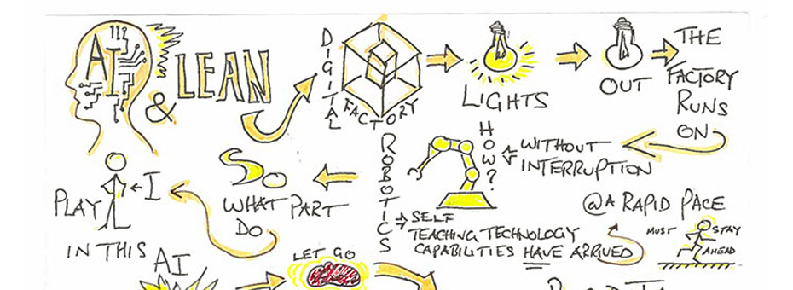
人才培養
2019 年, 有三大人工智能及大數據國際會議在澳門舉行，包括
The 28th International Joint Conference on Artificial Intelligence (IJCAI 2019)
35th IEEE International Conference on Data Engineering (ICDE 2019)
The Pacific-Asia Conference on Knowledge Discovery and Data Mining (PAKDD 2019)
為培養本地人材，從中學生開始
Macau AI Challenge 2019 for High School Students
15-16 Dec 會在澳門大學進行培訓工作坊

Slide 9

Why do you need to participate?
To improve data processing skills
How to handle GB or TB datasets
How to train data over a cloud system, e.g.,
How to extract features from data
To improve your programming skills
To make your STEM projects smarter
To let you attend the best AI conference on the world

Slide 10

The International Joint Conference on Artificial Intelligence (IJCAI) 2019
The 28th International Joint Conference on Artificial Intelligence (IJCAI) is a gathering of artificial intelligence researchers and practitioners for scientific and educational purposes, including dissemination of information on Artificial Intelligence in which cutting-edge scientific results are presented.
IJCAI-19 will be hosted in Macao. This will be the second time that IJCAI is held in China.
We expect 3000+ top AI researchers to attend the conferences and present their latest development.

Slide 11
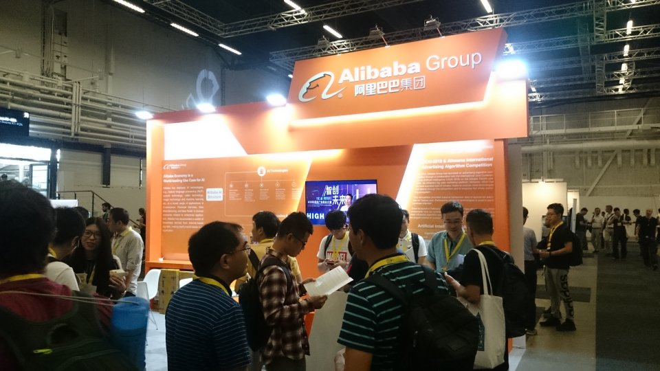

Slide 12
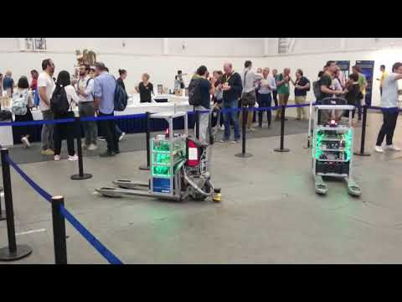

Slide 13
Macau AI Competition Introduction
2
Let’s continue with the second part of slides

Slide 14
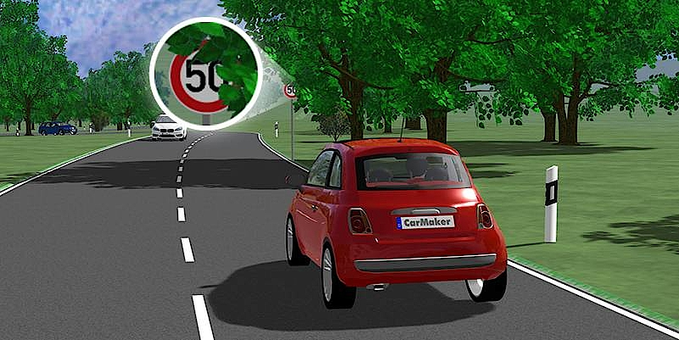
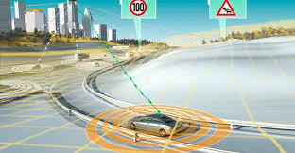
Goal: Traffic Road Sign Recognition
The goal of this task is to recognize the traffic road sign from a set of images.
Such algorithm is critical in the scenarios of intelligent transportation system (ITS), especially for navigation system and self-driving cars.

Slide 15
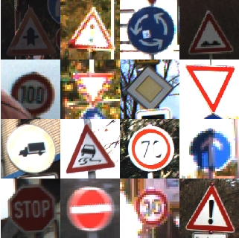
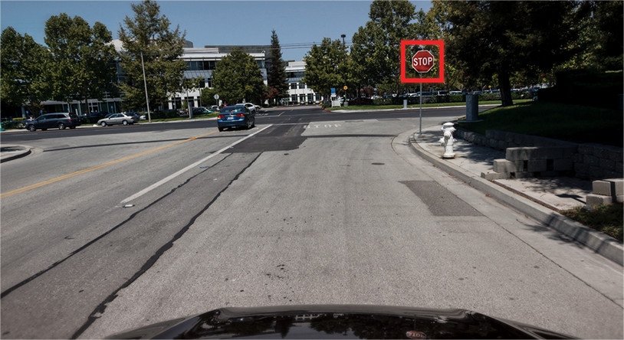
Goal: Traffic Road Sign Recognition
The challenging part of this task lies in the robustness of your proposed method(s) in different real-life situations, such as low light conditions, obstructions and far-away signs.

Slide 16
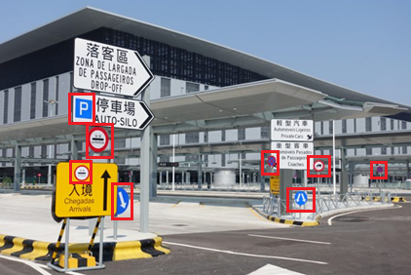
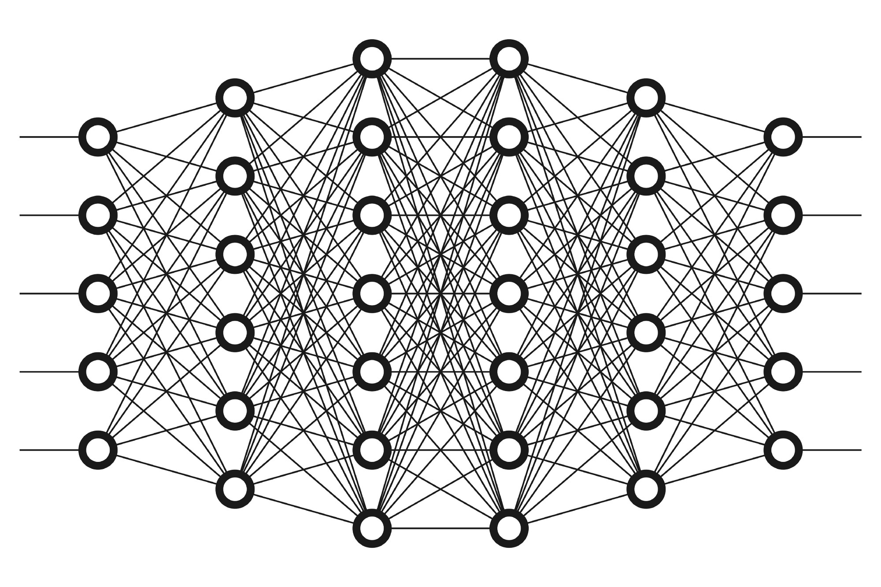
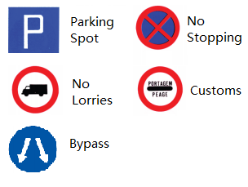
Two-step Processes
Training on labeled images
Evaluating on testing images
Labeled images
Training a learning model
(e.g., Neural Network)
Testing images

Slide 17
Datasets (drafted version)
The provided data are RGB traffic sign images of various sizes, cropped out of photos taken in real life scenarios.
We will provide a preliminary training datasets that include some pre-processed photos with labelled traffic sign(s).
File descriptions
train.zip: training datasets
test.zip: testing datasets
sample_submission.csv: a sample for submission format
http://conferences.cis.umac.mo/aichallenge/index.php/challenges/introduction/

Slide 18
Datasets – Training Datasets
The training dataset is being collected by our data collection portal (being discussed in the next part).
Each labeled image should contain the following
Image binary format
Label location(s) (x1, y1, x2, y2)
Label type(s)
Each of them is correctly matched into a type of traffic sign according to
道路交通標誌、標記及標線一般工作指引 (2016 年第二版) from DSAT
https://www.dsat.gov.mo/pdf/TrafficSignalHandBook_tc.pdf

Slide 19
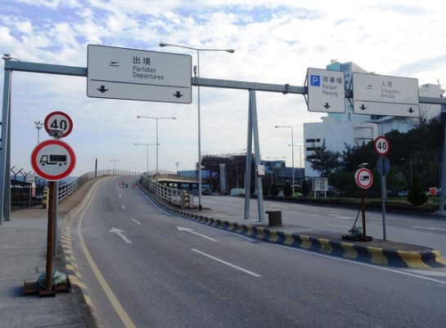
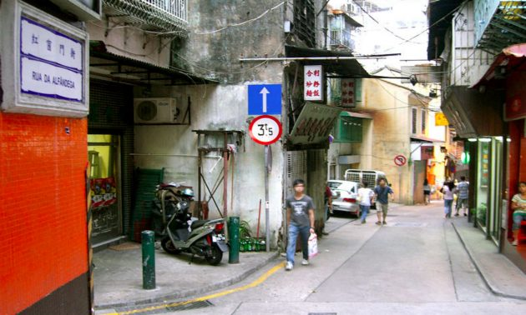
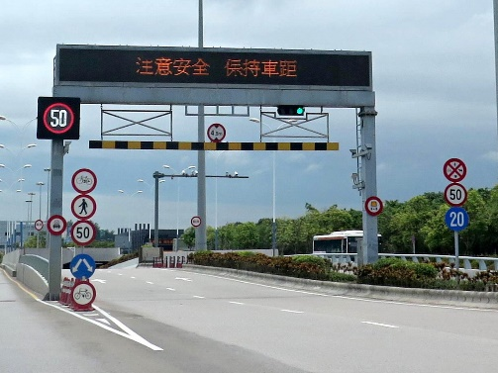
Datasets – Testing Datasets
In the test.zip, it includes a set of images containing traffic sign(s) and your task is to recognize the road traffic sign(s) inside.
E.g.,
Given the first image (of ID=1) in this page, your model only needs to return sth like
\where 20 and 12 are the IDs of the corresponding traffic signs, respectively, in image 1.
>> model(‘path of image01’,1)
1 20
1 12

Slide 20


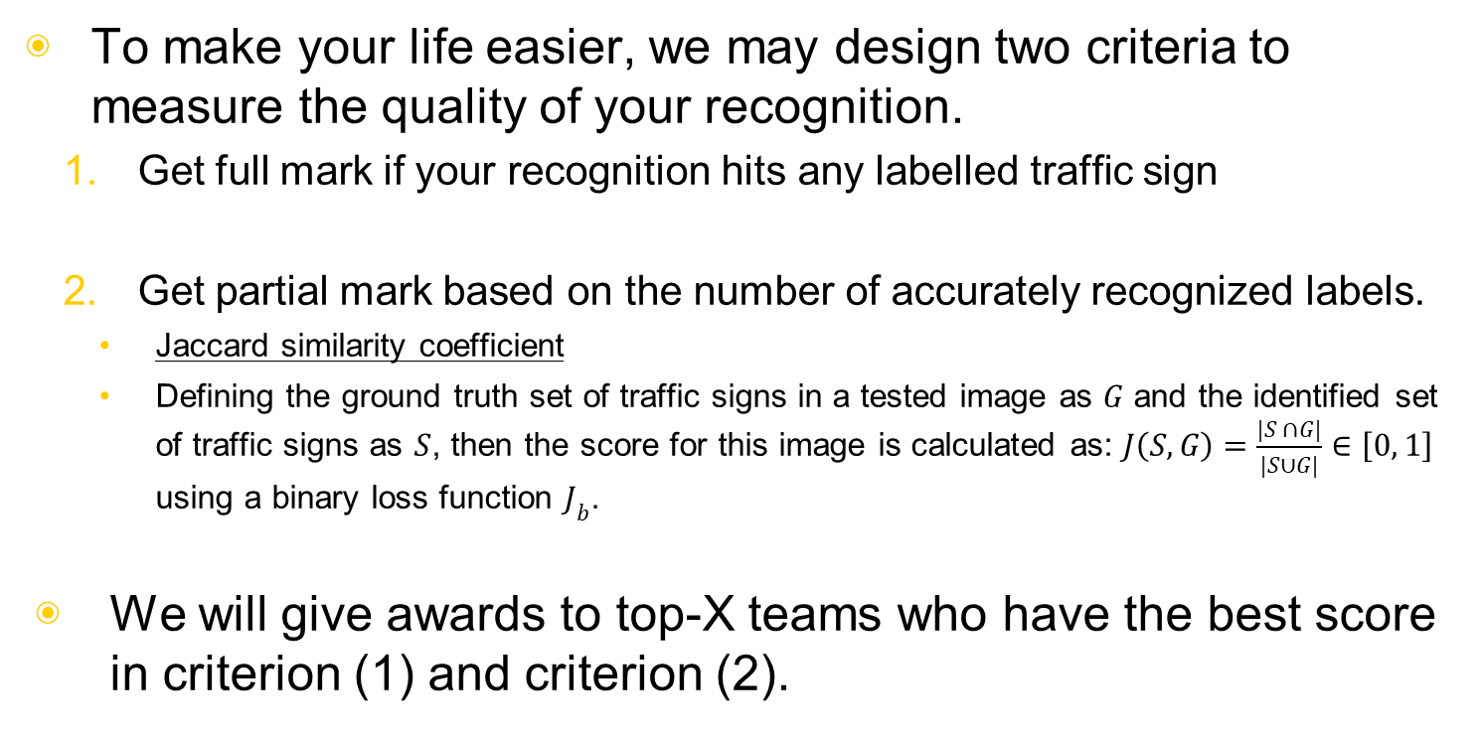
Evaluation Criteria (Drafted version)
To make your life easier, we may design two criteria to measure the quality of your recognition.
Get full mark if your recognition hits any labelled traffic sign
Get partial mark based on the number of accurately recognized labels.
Jaccard similarity coefficient
Defining the ground truth set of traffic signs in a tested image as $G$ and the identified set of traffic signs as $S$, then the score for this image is calculated as: $J\left(S,G\right)=\frac{|S ∩G|}{|S∪G|}∈\left[0, 1\right]$ using a binary loss function $J_{b}$.
We will give awards to top-X teams who have the best score in criterion (1) and criterion (2).

Slide 21
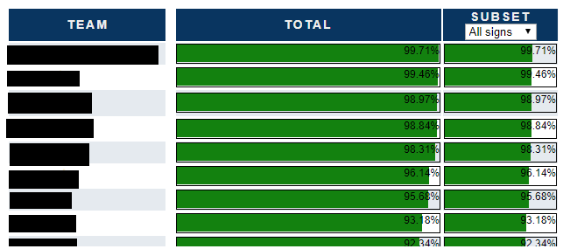
Leaderboard
When you upload your model (basically it is a function that returns the recognized result), the leaderboard will show you the ranking of your model.

Slide 22
Image Data Collection
3
Let’s continue with the third part of slides

Slide 23
We need you to
upload images and label images
Some reasons behind this the image data collection
More photos you have in hand, higher quality of the training model you will get.
Part of the final testing dataset will be sampled from your uploaded data
=> This translate a fact that more photos you uploaded, higher chance you will win the competition.
The images you uploaded and labelled will be used as a standard dataset for the further competitions and load data analysis tasks.
=> Clarity work

Slide 24
Other incentives
We will give you more resource on AlibabaCloud if the number of uploaded and labelled images of your team (or school) is higher than a threshold (e.g., 1000)
E.g., we may offer you a standalone GPU server equipped with v100 for the model training in July 2019 (one month before the competition).

Slide 25

Crowdsourcing
The basic idea of Crowdsourcing is to tap into the collective intelligence of the public in order to complete your tasks and/or better understand the needs of your target audience.

Slide 26




Crowdsourcing model
Workers
(e.g., designers)
Platform
(e.g., web site / APP)
Requesters
(e.g., users)

Slide 27
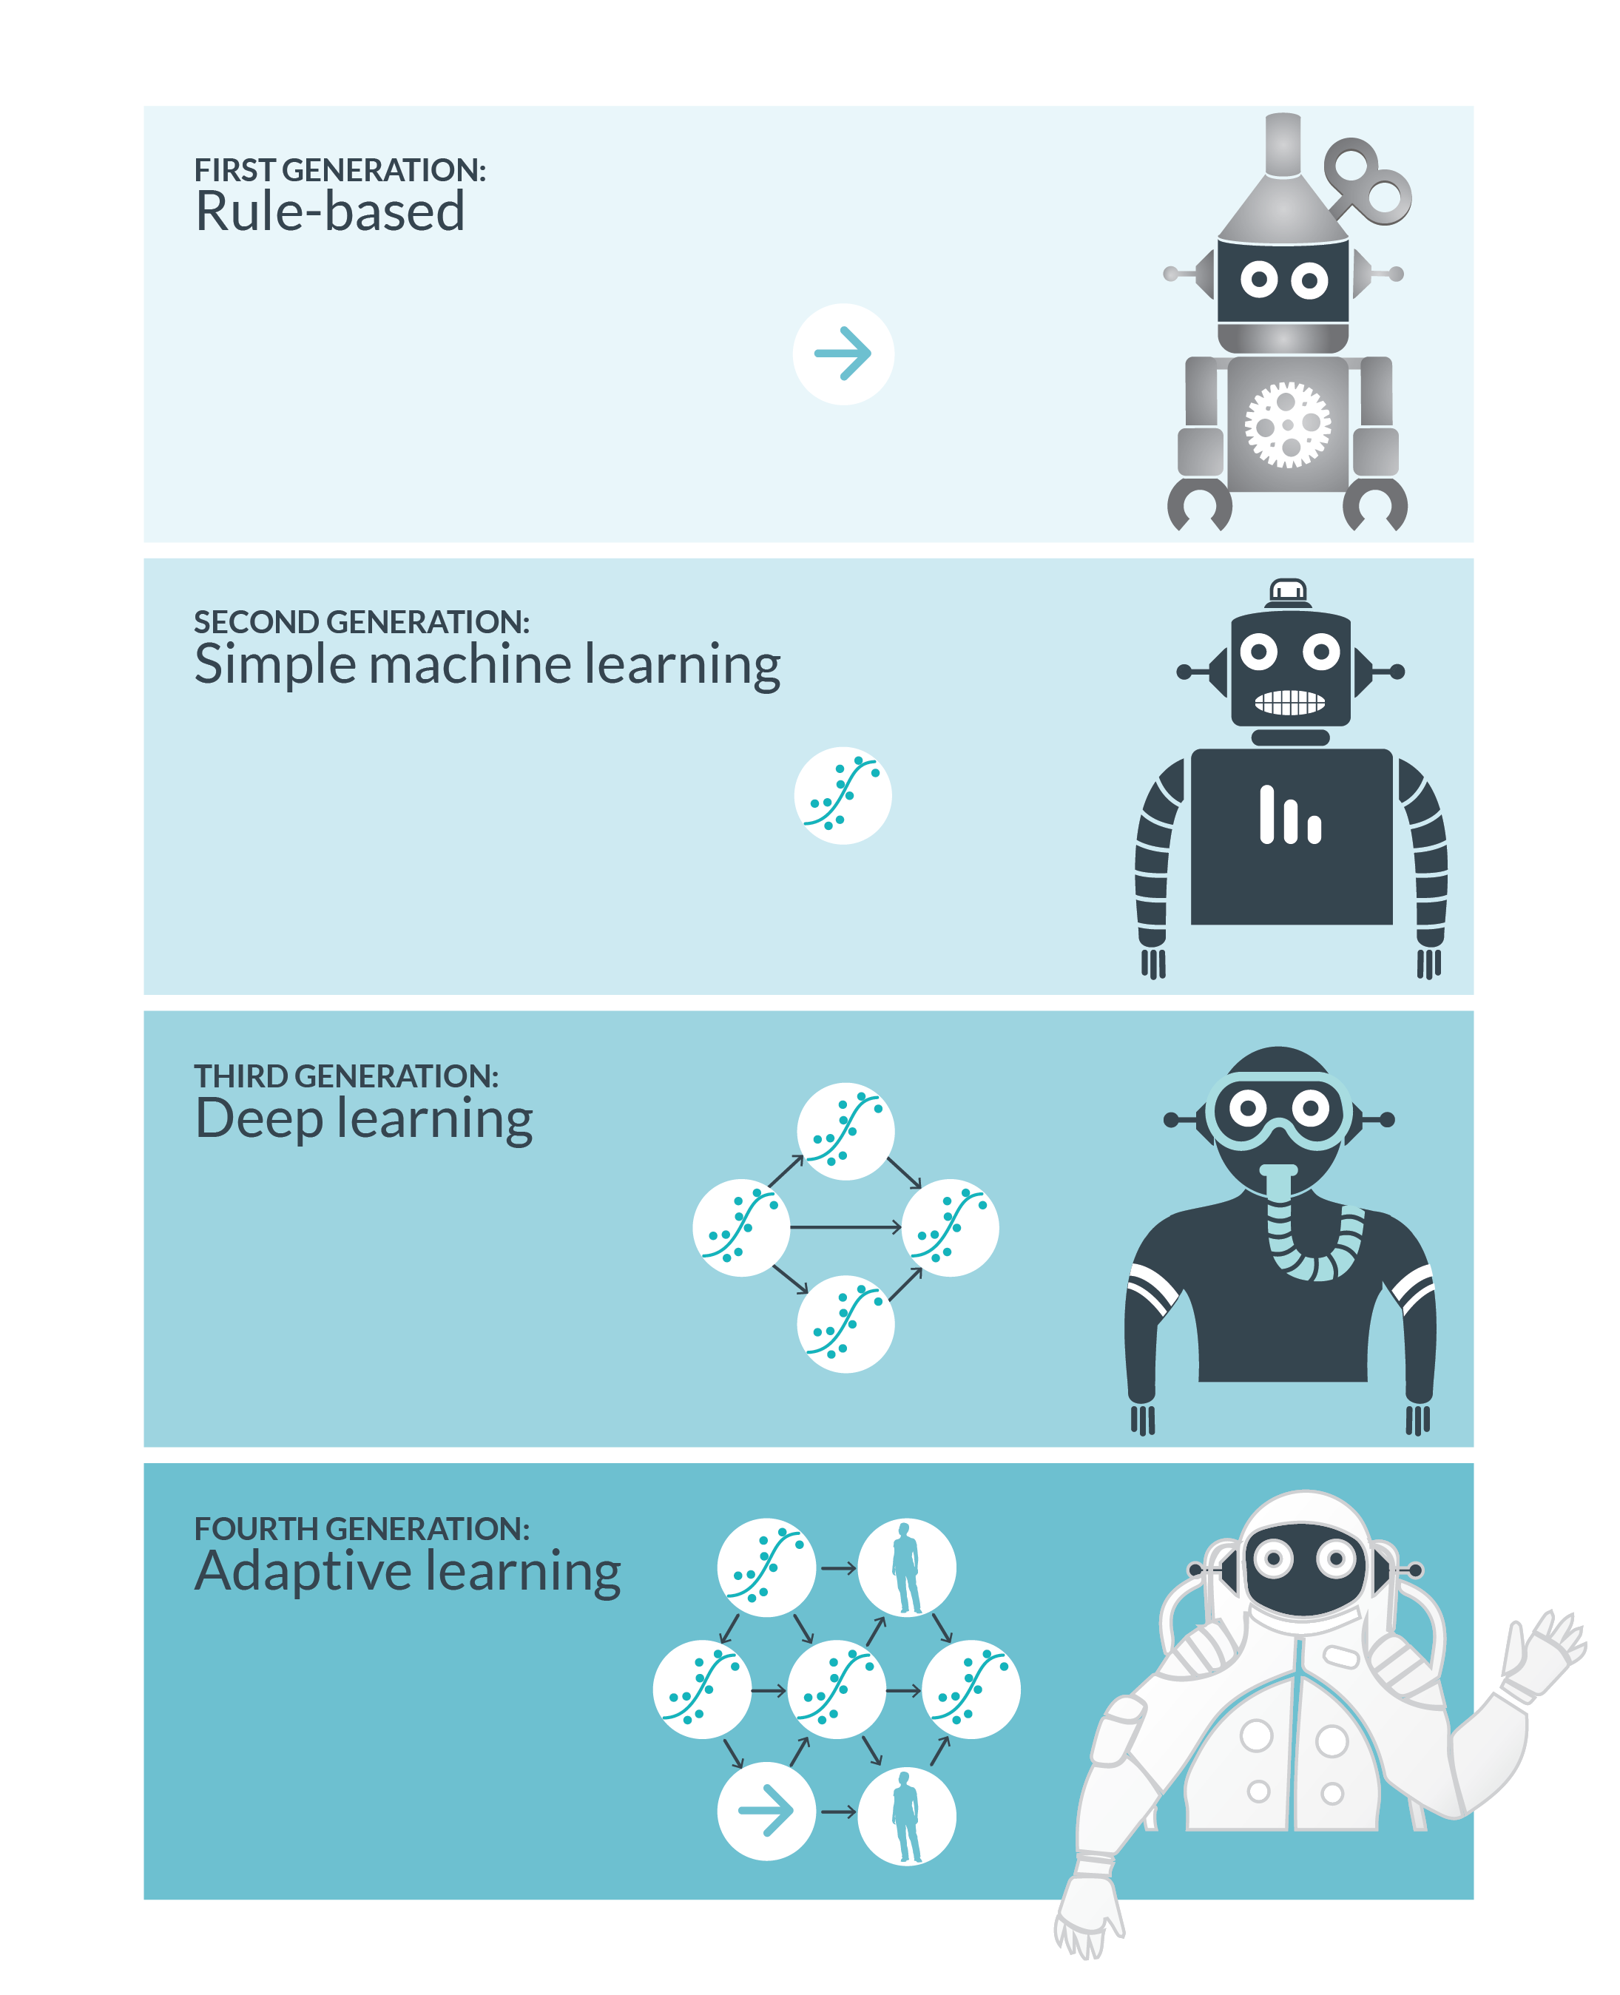
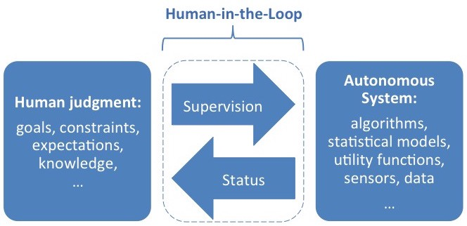
https://medium.com/mit-media-lab/society-in-the-loop-54ffd71cd802
http://robertmunro.com/blog_pics/robots.png

Slide 28



Crowdsourcing model
Worker Assignment
(e.g., based on expertise)
Truth Inference
(e.g., ranking by votes)
Workers
(e.g., designers)
Platform
(e.g., web site / APP)
Requesters
(e.g., users)

Slide 29

Truth Inference
Truth Inference decides how to effectively infer the answer based on the given data.
Let’s take the ranking as an example.

Slide 30

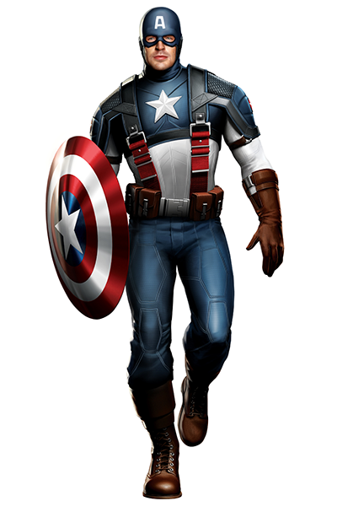
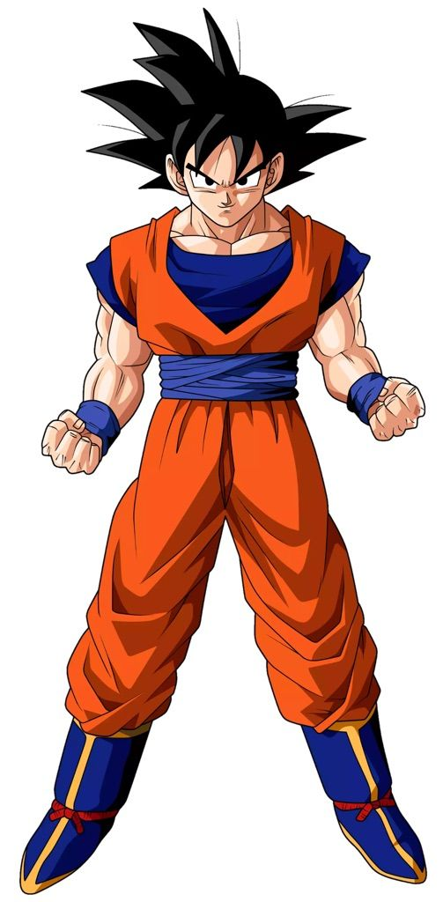


Truth Inference
Luk at Tu!
Who is the strongest anime character?

Slide 31


Truth Inference
Based on majority voting
70%
30%

Slide 32
Truth Inference
-
70%
49%
0%
According to the data collected from the crowd, we can conclude the ranking by topological sorting.
30%
-
40%
0%
51%
60%
-
0%
100%
100%
100%
-

Slide 33

Some Challenges
To rank the objects, is it necessary to compare every pair of objects, i.e., n(n-1)/2 pairs in total?
Do we use the same amount of crowd to conclude a pair of objects?

Slide 34
Challenges 1
-
70%
49%
0%
We can still draw the same conclusion even if some pair answers are omitted.
30%
-
40%
0%
51%
60%
-
0%
100%
100%
100%
-

Slide 35
Challenges 2
490 people
510 people
50 people
0 people
1000 people in total
50 people in total
The difficulty of comparing a pair should be considered more carefully.

Slide 36

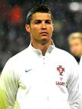
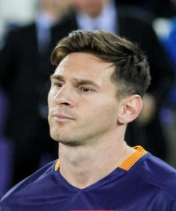






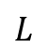
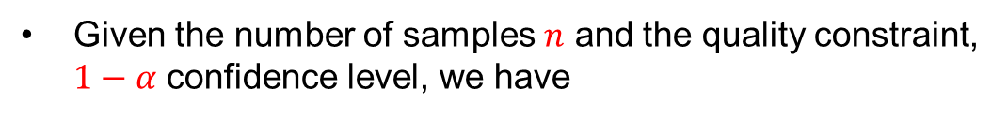
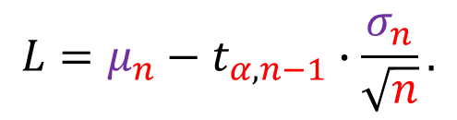
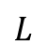
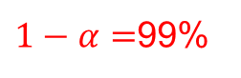

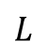
Confidence Interval (CI)
Given the number of samples $n$ and the quality constraint, $1−α$ confidence level, we have
mean and standard deviation of the samples
$$L=μ_{n}−t_{α,n−1}∙\frac{σ_{n}}{\sqrt{n}}.$$
With more samples, the confidence can be achieved.
Area =99%
$$L$$
$$L$$
0
$$L$$
$1−α=$99%
Distribution of $μ$
(average preference of every one)

Slide 37
Our Crowdsourced Top-k Query System
We address both challenges in our recent studies [1][2].
We proposed a Select-Partition-Rank framework to approach infimum cost.
The toolkit of this system is available online.
[1] Ngai Meng Kou, Yan Li, Hao Wang, Leong Hou U, Zhiguo Gong: Crowdsourced Top-k Queries by Confidence-Aware Pairwise Judgments. SIGMOD Conference 2017: 1415-1430
[2] Yan Li, Ngai Meng Kou, Hao Wang, Leong Hou U, Zhiguo Gong: A Confidence-Aware Top-k Query Processing Toolkit on Crowdsourcing. PVLDB 10(12): 1909-1912 (2017)

Slide 38
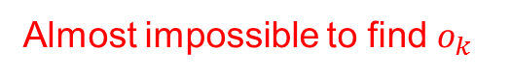
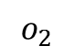
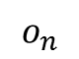
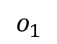
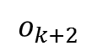
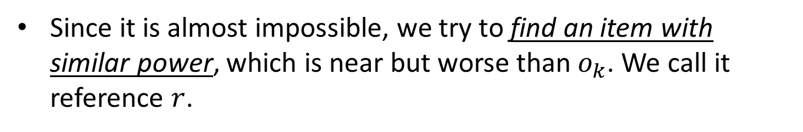
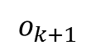
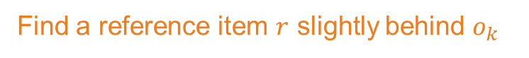
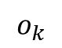

Select-Partition-Rank Framework
With the insights from the infimum cost solution, it will be efficient if the k-th item can be found in the early stage.
Find $o_{k}$
Almost impossible to find $o_{k}$
$$o_{1}$$
$$o_{2}$$
…
$$o_{k}$$
$$o_{k+1}$$
$$o_{k+2}$$
…
$$o_{n}$$
Total order:
Find a reference item $r$ slightly behind $o_{k}$
Since it is almost impossible, we try to find an item with similar power, which is near but worse than $o_{k}$. We call it reference $r$.

Slide 39



Select-Partition-Rank (SPR) Framework
Item set:
Sample
Intuition:
…
…
…
$x$ items
$x$ items
Consider the MAX item of a sample set.
Set 1
A set with one sample:
expected position is n/2.
Set m
MAX query
A set with n samples:
expected position is 1.
…
1.Select median as reference $r$
There is something in between.
Lemma 2. There exists a pair of integers x and m, such that r is a good reference with high probability.

Slide 40
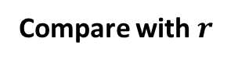
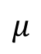
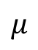
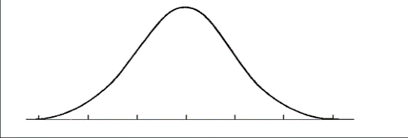
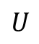
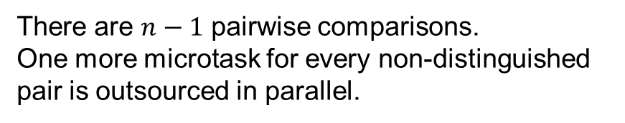
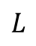
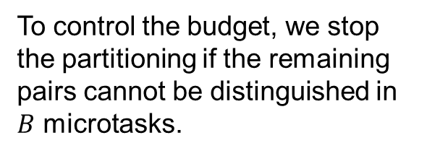
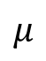

Select-Partition-Rank (SPR) Framework
Item set:
Compare with $r$
Partition the Item Set in Parallel
There are $n−1$ pairwise comparisons.
One more microtask for every non-distinguished pair is outsourced in parallel.
Partition item set
Winners
Ties
Losers
To control the budget, we stop the partitioning if the remaining pairs cannot be distinguished in $B$ microtasks.
$$U$$
0
$$μ$$
$$L$$
0
$$μ$$
0
$$L$$
$$μ$$
Winners
Ties
Losers

Slide 41




Select-Partition-Rank (SPR) Framework
…
Key Observation:
Winners
Candidates
Based on their pairwise comparisons with the reference item $r$, we may obtain a good initial order of those top-$k$ candidates.
Reference-base Rank
…
Near-sorted list
Rank
0
$$μ_{r,j}$$
$$μ_{r,i}$$
Top 1
If $o_{i}$ is much better than $r$ and the other item $o_{j}$ is just slightly better, there is a high chance $o_{i}≻o_{j}$.
Top 2
…
Best-case linear sorting algorithms can ﬁnd the top-k items eﬃciently.
Top k

Slide 42







An example in Macau
Citizen
Reconstruct
Hotel Estoril e Piscina Municipal
愛都酒店
Truth Inference
(e.g., our solution)

Slide 43


Place Pulse (MIT)
Comparing living environments
Place Pulse aims to quantitatively recognize which areas of a city are perceived as wealthy, modern, safe, lively, active, unique, central, adaptable or family friendly.

Slide 44
A good use of human intelligence will make our city smarter
c
c
c

Slide 45
Image Data Collection Mobile APP
3

Slide 46

Login

Slide 47

Login
Choose Image

Slide 48

Login
Choose Image
Recognize Traffic Sign

Slide 49

Login
Choose Image
Recognize Traffic Sign
Select Label Matched

Slide 50
Login
Choose Image
Recognize Traffic Sign
Select Label Matched
Upload

Slide 51

Login
Choose Image
Recognize Traffic Sign
Select Label Matched
Upload
Match Location

Slide 52
Step 1. Login your account
Step 2. Choose your image

Slide 53
Step 5. Upload information
Step 3. Recognize traffic sign
Step 4. Select label matched

Slide 54
Step 6. Showing locational information

Slide 55
What you will learn in this workshop
4
Let’s continue with the fourth part of slides

Slide 56
Artificial Intelligence or Machine Learning
Do we learn a lot of the Artificial Intelligence technologies after attending this workshop?
If you want to say “yes”, then I would say “people ng smile, dog knife braking”
Actually this workshop can only cover a very limited part of AI, that is Machine Learning (ML) technologies.

Slide 57

What’s Machine Learning?
Session 1
Session 2
Session 3 & 4
Session 1

Slide 58





To complete a Machine Learning task
Computation environment & Data preparation
By Crowd or By sensors
Software setup and Hardware setup
Large data management technologies (not covered in this workshop)
Feature extraction
RGB in images
Shape or texture
Machine learning algorithms
k Nearest Neighbor
Support Vector Machine
Random Forest
Neural Networks

Slide 59
Neural Network and Deep Learning

Slide 60

Neural Network and Deep Learning

Slide 61






AUGMENTING HUMAN INTELLIGENCE MOVING FORWARD
Traffic images / videos
Urban feature data
Satellite images and data
Complex path information

Slide 62
Environment Setup
5
Let’s continue with the fifth part of slides

Slide 63
Hardware facilities
You do not have to be worried about the computation resources.
For small datasets (at the beginning of the competition)
Hundreds to thousands image
You can finish everything in your laptop or desktop
For large datasets, we will offer you several options
Build a workstation equipped with 1-2 GPU cards (e.g., RTX 2080)
Use AlibabaCloud service, as I claim that you will get more resources if your team contributes more on the data collection.
Come to our and use the workstations equipped with RTX 2080 x 2 and 64GB machines

Slide 64


澳門中小學生科技實踐基地科學暨工程科普推廣中心
https://umstem.um.edu.mo/en/

Slide 65

What do I need to install when I use my laptop
We suggest you to install Anaconda
Anaconda is an AI/ML enablement platform that empowers organizations to develop, govern, and automate AI/ML and data science from laptop through training to production.

Slide 66
Anaconda Setup
Windows
Anaconda install
PIP install
TensorFlow install
Keras install
OpenCV install
PyCharm install
MAC
Anaconda install
PIP install
TensorFlow install
Keras install
OpenCV install
PyCharm install

Slide 67

Package installation order
Anaconda
PIP
pip is a package management system used to install and manage software packages written in Python.
TensorFlow
TensorFlow is an open-source software library for dataflow programming across a range of tasks. It is a symbolic math library, and is also used for machine learning applications such as neural networks.
Keras
Keras is an open source neural network library written in Python. It is capable of running on top of TensorFlow, Microsoft Cognitive Toolkit, or Theano.
OpenCV
OpenCV is a library of programming functions mainly aimed at real-time computer vision.
PyCharm
IDE (this is the student choice)
For myself , I love to use Visual Studio Code (free) or Sublime (non-free) more

Slide 68

Install Anaconda
Windows Operating System
Go to URL: https://repo.anaconda.com/archive/ and choose the follow option Anaconda3-5.2.0-Windows-x86_64.exe:
Macintosh Operating System
Go to URL: https://repo.anaconda.com/archive/ and choose the follow option Anaconda3-5.2.0-MacOSX-x86_64.pkg:
Do not install the latest version since the latest version may have problem to be used with other packages.

Slide 69

Install Anaconda (Windows Operating System)
click next and click “Add Anaconda to my PATH environment variable” in Advanced installation Options

Slide 70


Install Anaconda (Windows Operating System)
click Install and click ‘Skip’

Slide 71

Install Anaconda (Windows Operating System)
Click Finish to end installation process

Slide 72

Install Anaconda (MAC Operating System)
click Anaconda3-5.2.0-MacOSX-x86_64.pkg and you can click “next” directly in dialog ‘Introduction’, ’Read Me’, ‘License’ and choose ‘Install for me only’ in dialog ‘Destination Select’:
Note: if there is any warning message ‘You cannot install Anaconda in this location’, Reselect ‘ Install for me only’ and click dialog ‘next’.

Slide 73

Install Anaconda (MAC Operating System)
In dialog ‘Installation Type’. You can change the installation location by clicking "Change Install Location". The standard installation path is in the user's home directory. I did not change the installation location in this step. If you choose the default installation path, just click "Install" to install.

Slide 74

Install Anaconda (MAC Operating System)
Wait for the "Installation" section to end. If you see "The installation was completed successfully." in the "Summary" section, the installation is successful. Click "Close" to close the dialog box.

Slide 75

Install Anaconda (MAC Operating System)
Set anaconda environment
Input the following command in Terminal:
vim ~/.bash_profile
（input :i to enter edit mode）
alias python=/Users/(your location)/anaconda3/bin/python3.6
(input ESC to quit edit mode and input :wq to save and quit)
source ~/.bash_profile

Slide 76

Install pip
Windows Operating System
Click the https://bootstrap.pypa.io/get-pip.py to download the get-pip file
Then run the following in CMD:
python get-pip.py
MAC Operating System
Click the https://bootstrap.pypa.io/get-pip.py to download the get-pip file
Open terminal and input the following
python get-pip.py

Slide 77

Install tensorflow
Windows Operating System
Then run the following in CMD:
pip install tensorflow
MAC Operating System
Open terminal and input the following
pip install tensorflow

Slide 78

Install kersa
Windows Operating System
Then run the following in CMD:
pip install keras
MAC Operating System
Open terminal and input the following
pip install keras

Slide 79

Install OpenCV
Windows Operating System
Then run the following in CMD:
pip install opencv-python
MAC Operating System
Open terminal and input the following
pip install opencv-python

Slide 80



Install PyCharm
Enter PyCharm's official website https://www.jetbrains.com/pycharm/download/#section=windows
Windows Operating System
MAC Operating System
As shown in the figure below, open the installation package and drag and drop the PyCharm icon to the folder:

Slide 81




Install PyCharm
Windows Operating System

Slide 82


